Slide 1


SMART INDIA HACKATHON 2024
TITLE PAGE
Problem Statement ID –
Problem Statement Title-
Theme-
PS Category- Software/Hardware
Team ID-
Team Name (Registered on portal)

Slide 2
IDEA TITLE
CODESTRIX
Problem Resolution :
Multifactor authentication system delivers seamless security, excelling even in the most challenging low network zones.
Eliminates vulnerabilities of traditional 6-digit OTPs, offering unbreachable security that redefines industry standards.
IDEA / SOLUTION :
Implementation of a Time-based itunique One-time Handshake (OTH) Mechanism specialized for low network zones
USSD triggered offline authentication mechanism
Advanced QR based high speed multi-factor authentication
Unique UID,phone number and stamp to auto authenticate/authorize user
Alternative IMEI based OTH methodology for button phone uses
Capability to work efficiently without internet even in low network zones
Unique Value Propositions (UVP) :
Dynamic prompt Stamp for every Authentication
Authenication done in less than a second
Functions with full efficiency even without Internet
Quad Level Custom Encryption Algorithm
Distinct API's enhance Security standards

Slide 3
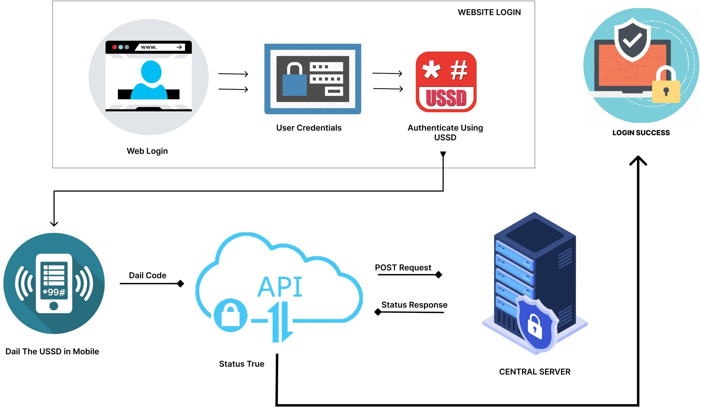
TECHNICAL APPROACH
CODESTRIX
PROCESS FLOW ARCHITECTURE
Algorithm Development:
Next.js & Express.js - Core technologies used for developing the OTH Algorithm.
Mobile Application Development:
Flutter - Framework used for building the mobile application, ensuring cross-platform compatibility.
Encryption and Security:
Custom encryption algorithm powered by 8 layer octa 512 bit encryption for secure data transmission and authentication.
Cloud Services:
MySQL - Relational database management
PHP - High responsive Rest APIs
Product Status: 80% product built completed and further build is on progress. Testing and validation process are next to be undergone

Slide 4
FEASIBILITY AND VIABILITY
Your Team Name
Analysis of the feasibility of the idea
Technical, Financial, Market, Operational
Potential challenges and risks
Technical, Financial, Market, Operational
Strategies for overcoming these challenges Methods, principle, Strategies, Algorithms

Slide 5
IMPACT AND BENEFITS
Your Team Name
Potential impact on the target audience
Positive- Improvement , Economical, New Opportunities, socialbenefits negative- Cost, Technology Adoption Issues
Benefits of the solution (social, economic, environmental, etc.)
Social - Improved Access, Empowerment, Reduction
Economic – Productivity, Cost, Market
ENV – Energy, Reduction, Waste

Slide 6
RESEARCH AND REFERENCES
Your Team Name
Details / Links of the reference and research work
Elsevier , Science Direct

Slide 7
IMPORTANT INSTRUCTIONS
Please ensure below pointers are met while submitting the Idea PPT:
Kindly keep the maximum slides limit up to six (6). ( Including the title slide)
Try to avoid paragraphs and post your idea in points /diagrams / Infographics /pictures
Keep your explanation precise and easy to understand
Idea should be unique and novel.
You can only use provided template for making the PPT without changing the idea details pointers (mentioned in previous slides).
You need to save the file in PDF and upload the same on portal. No PPT, Word Doc or any other format will be supported.
Note - You can delete this slide (Important Pointers) when you upload the details of your idea on SIH portal.

